Slide 1





NAAN MUDHALVAN-NIRAL THIRUVIZHA
UNIVERSITY COLLEGE OF ENGINEERING
DEPARTMENT OF CSE
2nd Review Date:07/05/2026
17. How might we utilize AI chatbots and machine learning to address the challenges of incomplete alleviation of depression symptoms, attrition, and loss of follow-up in mental health treatment
MAJOR AREA:Artificial Intelligence in Mental Healthcare (AI-based Clinical Decision & Therapeutic Support System)
PRESENTED BY
Dr. SIVANESH., B.Tech .,M.Tech., Ph.D.,
DEPARTMENT OF CSE
GUIDED BY
MADHUMATHI S(422623104003)
BALAJI P(422623104035)
MALINI V(422623104048)

Slide 2
ABSTRACT
Keffi AI is a Clinical Digital Therapeutics Platform designed to improve digital mental healthcare by overcoming
the limitations of existing chatbots, which lack memory, personalization, and clinical safety.
The system uses BERT-based emotion analysis to classify user input into 96 clinically relevant emotional states,
enabling deeper understanding beyond basic sentiment detection. It also incorporates a vector-based memory system
to retain past conversations and build a continuous psychological profile of the user.
A dynamic Mental Health Quotient (MHQ) tracks user condition in real time, while a predictive attrition algorithm
identifies early signs of disengagement and emotional decline. The platform integrates an automation layer (n8n) to
trigger real-time interventions such as alerts, reminders, and crisis responses.
Keffi AI provides both a patient interface for interaction and a clinical dashboard for monitoring, bridging the gap
between self-help tools and professional mental healthcare.

Slide 3
PROBLEM STATEMENT
How might we utilize AI chatbots and machine learning to address the challenges of incomplete alleviation of depression symptoms, attrition, and loss of follow-up in mental health treatment.
Three Interconnected Challenges
1. Incomplete Alleviation of Depression Symptoms
Current treatments — therapy and medication — work for many, but not completely for all. Studies show that nearly 50–60% of depression patients don't achieve full remission after a first-line treatment. This happens because:
Treatment is often one-size-fits-all
Symptom tracking between sessions is inconsistent or absent
Patients suffer in silence between weekly or monthly appointments
There's a significant gap between clinic visits where symptoms can worsen undetected
2. Attrition — Dropping Out of Treatment
A large portion of patients abandon treatment prematurely, often before meaningful progress is made. Key reasons include:
Stigma around seeking continued mental health support
Cost and accessibility barriers — therapy is expensive and geographically limited
Lack of motivation when progress feels slow or invisible
Feeling disconnected from a therapist they see infrequently
3. Loss to Follow-Up
Even patients who complete an initial treatment course often disappear from care entirely. This is dangerous because:
Depression is episodic and recurring — without follow-up, relapse goes undetected
There's no system proactively reaching out to at-risk patients
Clinicians are overwhelmed and cannot manually track hundreds of patients
The handoff between crisis care and long-term care is often broken

Slide 4
SOLUTION
Keffi AI is designed as a clinical mental health support system, not just a chatbot. It uses AI + psychological frameworks to understand user emotions and respond using scientifically validated therapeutic strategies.
Instead of giving generic replies, Keffi:
Analyzes user emotion in real-time
Selects the best therapeutic response type
Provides personalized, safe, and structured support
Keffi’s 7 Therapeutic AI Response Types
1.Validation & Empathy
Accepts user feelings without judgment
Builds emotional trust
Based on: Person-Centered Therapy Proof: 30% therapy success depends on feeling understood
2.Metaphor & Storytelling
Uses simple stories or analogies
Helps users process emotions gently
Based on: Acceptance & Commitment Therapy (ACT) Proof: Helps in cognitive defusion (reduces overthinking)

Slide 5
3.Grounding & Somatic Techniques
Breathing exercises (4-7-8)
Brings user to present moment
Based on: Polyvagal Theory & MBSR Proof: Reduces panic by 45–50%
4.Cognitive Reframing (CBT)
Changes negative thinking patterns
Builds positive mindset
Based on: Cognitive Behavioral Therapy (CBT) Proof: 50–75% reduction in depression & anxiety (WHO approved)
5.Reflective Questioning
Asks open-ended questions
Helps users understand themselves
Based on: Motivational Interviewing Proof: Improves self-awareness & behavior change
6.Guided Options (Quick Replies)
Provides A/B/C choices
Reduces mental effort
Based on: Cognitive Load Theory Proof: Reduces decision fatigue & user dropout
7.Crisis Intervention (SOS)
Detects suicidal or high-risk signals
Triggers emergency support
Based on: WHO Suicide Prevention Protocols Proof: Ensures clinical safety & ethical compliance

Slide 6
EXISTING SYSTEM
1.Rule-Based Chatbots(Examples: Woebot, Wysa)
Rule-based chatbots like Woebot and Wysa operate on simple keyword matching. When a user types a message, the bot identifies a keyword and returns a pre-written response — the same answer every time, regardless of context or emotional depth. There is no real AI understanding behind the conversation. After just 2 to 3 sessions, patients begin to feel the robotic nature of the interaction. These systems have zero clinical diagnosis ability, carry no memory between sessions, and involve no doctor at any point in the process.
2.LLM Wrappers(Examples: ChatGPT-based Mental Health Bots)
LLM-based mental health bots are essentially ChatGPT with a mental health prompt layered on top. The user's message — including all personal details — is sent directly to OpenAI's servers with no anonymization or privacy filtering. These systems have no emotion classification, no PHQ or MHQ scoring, and no follow-up mechanism. Because they are generative models, they carry a high hallucination risk — meaning they can confidently produce incorrect or even harmful clinical advice. They are not HIPAA compliant and have no awareness of the patient's history or mental health trajectory.
3.Traditional Therapy Apps(Examples: BetterHelp, Talkspace)
Traditional therapy platforms like BetterHelp and Talkspace connect patients with licensed human therapists. While this provides genuine clinical value, it comes with serious limitations in scalability and accessibility. Sessions cost between $60 to $100 per hour, require patients to wait days or even weeks for an appointment, and offer no real-time monitoring between sessions. There is no crisis detection between appointments, no automated intervention if a patient stops engaging, and no 24/7 availability. For patients in rural India — where language barriers and cultural stigma already limit access — these platforms are practically out of reach.

Slide 7
RESEARCH AND SCIENTIFIC VALIDATION
CBT Effectiveness (Cognitive Reframing)
Paper:
Hofmann, S. G., Asnaani, A., Vonk, I. J. J., Sawyer, A. T., & Fang, A. (2012). The Efficacy of Cognitive Behavioral Therapy: A Review of Meta-analyses. Cognitive Therapy and Research, 36(5), 427–440.
CBT is WHO & APA's gold standard — proven 50–75% success rate in reducing depression and anxiety symptoms across multiple meta-analyses.
Empathy & Therapeutic Alliance (Person-Centered)
Paper:
Norcross, J. C., & Wampold, B. E. (2011). Evidence-based therapy relationships: Research conclusions and clinical practices. Psychotherapy, 48(1), 98–102.
Therapeutic alliance alone — the feeling of being heard — accounts for 30% of treatment success, independent of medication or technique.
ACT & Mindfulness (Grounding & Metaphors)
Paper:
Hayes, S. C., Luoma, J. B., Bond, F. W., Masuda, A., & Lillis, J. (2006). Acceptance and Commitment Therapy: Model, processes and outcomes. Behaviour Research and Therapy, 44(1), 1–25.
NHS-recommended ACT & mindfulness techniques reduce panic attacks and extreme anxiety by 45–50% through grounding and breathing exercises.

Slide 8
AI Chatbot Proof — The Woebot Study (YOUR STRONGEST CARD)
Paper:
Fitzpatrick, K. K., Darcy, A., & Vierhile, M. (2017). Delivering Cognitive Behavior Therapy to Young Adults With Symptoms of Depression and Anxiety Using a Fully Automated Conversational Agent (Woebot): A Randomized Controlled Trial. JMIR Mental Health, 4(2), e19.
In just 2 weeks, an AI chatbot using CBT & empathy reduced depression symptoms by 22% — scientifically validated via randomized controlled trial at Stanford University.
Crisis Intervention & SOS Protocol
Reference Tool:
Posner, K., et al. (2011). The Columbia–Suicide Severity Rating Scale: Initial Validity and Internal Consistency Findings From Three Multisite Studies With Adolescents and Adults. American Journal of Psychiatry, 168(12), 1266–1277.
Keffi's SOS system follows WHO Suicide Prevention Guidelines and the clinically validated C-SSRS triage protocol — ensuring safe human escalation when AI detects crisis signals.

Slide 9
96-STATE CLINICAL EMOTION MODEL
DEPRESSION (41 TYPES)
MDD – 2+ weeks severe sadness
PDD – Chronic mild depression 2+ yrs
Bipolar – High vs low mood swings
Postpartum – After childbirth depression
SAD – Seasonal depression
Psychotic – With hallucinations
PMDD – Before periods mood issues
Atypical – Temporary mood lift + oversleep
DMDD – Child anger disorder
TRD – Not responding to treatment
Substance-induced – Due to drugs/alcohol
Medical-condition – Due to illness
Smiling – Hidden depression
Melancholic – No pleasure at all
Agitated – Restless + overthinking
Double – Mild + severe combo
Minor – Less severe MDD
Catatonic – No movement state
Endogenous – Internal chemical cause
Reactive – Due to life event
Existential – Meaning-of-life sadness
Masked – Physical pain instead
Geriatric – Elderly depression
Recurrent Brief – Short repeated episodes
Unipolar – Only low mood
Vascular – Blood flow issue
Cyclothymia – Mild bipolar
Mixed Anxiety – Anxiety + depression
Perimenopausal – Menopause-related
Post-Schizo – After schizophrenia
Adjustment – Life change stress
Antenatal – During pregnancy
Prolonged Grief – Long-term grief
Male Syndrome – Anger/risk behavior
Burnout – Work stress exhaustion
Anergic – No energy state
D-MER – Breastfeeding sadness
PCD – After intimacy sadness

Slide 10
ALLEVATION (18 STATES)
Partial Response – Only partial recovery
Residual Symptoms – Some symptoms remain
Tachyphylaxis – Drug stops working
Breakthrough – Depression returns
TRD – No response to treatment
Full Remission – Complete recovery
Sustained Recovery – Stable long-term
Spontaneous – Auto recovery
Placebo – Belief improves state
Nocebo – Negative belief worsens
Honeymoon – Short-term improvement
Relapse – Return before recovery
Recurrence – New episode later
Pseudo-resistance – Improper treatment issue
Emotional Blunting – No emotions
TEAS – Switch to mania
Withdrawal – Stopping drug effects
ATTRITION (20 TYPES)
Voluntary – Leave by choice
Involuntary – Forced removal
Internal – Shift within org
Demographic – Retirement/death
Regrettable – Loss of top talent
Non-regrettable – Low performer leaves
New-hire – Early exit
Veteran – Long-term exit
Customer churn – Service leaving
Student dropout – Education quit
Mechanical – Wear & tear
Dental – Teeth wear
Geological – Rock erosion
War attrition – Loss in war
Clinical trial – Patient dropout
Therapeutic – Stop treatment
Data loss – Packet loss
LOSS OF FOLLOW-UP (17 TYPES)
Voluntary Withdrawal – Stops by choice
Non-compliance – Avoids treatment
Cured perception – Thinks cured
Unintentional – Missed visits
Silent loss – No contact
Passive dropout – Ignores follow-up
Active dropout – Informs and leaves
Death – Patient expired
Morbidity – Too ill to come
Geographic – Moved away
Economic – Cannot afford
Stigma – Social fear
Admin loss – System error
Provider relocation – Doctor changed
Protocol burden – Too complex
Intermittent – Returns later
Permanent – Never returns

Slide 11
LITERATURE SURVEY
Title | Author(s) | Year | Methodology / Approach | Dataset Used | Key Findings
Emotion Detection using Deep Learning | A. Kumar, R. Singh | 2021 | BERT-based emotion classification model | GoEmotions Dataset | Deep learning improves accuracy in multi-emotion detection
Sentiment Analysis for Mental Health Monitoring | J. Smith et al. | 2020 | NLP-based sentiment classification using machine learning | Twitter Dataset | Social media data can effectively detect emotional states
AI Chatbots for Mental Health Support | L. Johnson | 2019 | Rule-based + AI chatbot system | Custom conversational dataset | Chatbots provide accessible and immediate support
Detecting Depression from Text | M. Sharma et al. | 2022 | LSTM and NLP techniques | Reddit Mental Health Dataset | Language patterns can indicate early depression signs
Multi-Emotion Classification using Transformers | P. Verma | 2023 | Transformer models (BERT, RoBERTa) | GoEmotions | Transformers outperform traditional ML models

Slide 12
PHQ + MHQ HYBRID SCORING SYSTEM
PHQ (Patient Health Questionnaire)
Standard clinical assessment tool
Score Range: 0 – 27
Severity Levels:
0 – 4 → Minimal (0–15%)
5 – 9 → Mild (16–33%)
10 – 14 → Moderate (34–52%)
15 – 19 → Moderately Severe (53–70%)
20 – 27 → Severe (71–100%)
MHQ (Mental Health Quotient – Keffi AI)
AI-based dynamic scoring system
Score Range: 0 – 100
State Levels:
80 – 100 → Healthy / Thriving
60 – 79 → Stable
40 – 59 → Mild Risk
20 – 39 → Moderate Risk
0 – 19 → Critical

Slide 13
The Clinical Brain — BERT + Fast API
BERT = Bidirectional Encoder Representations from Transformers
It reads patient text both left-to-right AND right-to-left simultaneously
This means it understands context, not just keywords
Patient Message
↓
① REACT UI → Voice/Text captured via Web Speech API
↓
② FASTAPI GATE → PII Stripped (Name/Phone/Location removed)
↓
③ BERT ENGINE → 96-State Emotion Analysis + Confidence %
↓
④ PINECONE MEMORY → Past memories matched by similarity score
↓
⑤ MHQ CALCULATOR → Live score updated (0–100 dynamic)
↓
⑥ DUAL RESPONSE → Backend: Doctor Report | Frontend: Empathy Chat
BERT Output Example:
Patient says:
"I've been feeling tired, nothing excites me anymore...“
BERT detects:
Sadness → 84.3%
Hopelessness → 71.2%
Anhedonia → 68.9%
Exhaustion → 61.4%
Joy → 2.1%
BERT measures. FastAPI protects. Pinecone remembers. Claude speaks. — All in under 2 seconds.

Slide 14
RAG (Retrieval-Augmented Generation) – Intelligent Memory & Clinical Knowledge Engine
Keffi AI uses RAG (Retrieval-Augmented Generation) to provide emotionally accurate, context-aware, and personalized mental health support instead of giving generic chatbot replies. The RAG system combines the power of Large Language Models with a secure emotional memory database to retrieve relevant patient history, emotional patterns, therapeutic responses, and clinically validated mental health knowledge in real time.
How RAG Works in Keffi AI
User Interaction Input The user shares emotions, stress, anxiety, panic, or depressive thoughts through chat.
Emotion & Intent Analysis The AI analyzes the user’s emotional state, severity level, behavioral intent, and conversation context using NLP and sentiment analysis.
Retrieval from Memory & Knowledge Base RAG retrieves:
Previous emotional conversations
Patient mood history
Therapy-based response patterns
CBT/ACT psychological frameworks
Crisis intervention protocols
Personalized coping strategies
Context-Aware AI Generation The LLM generates highly empathetic and clinically aligned responses based on the retrieved emotional context rather than random internet-generated answers. Continuous Emotional Learning Keffi continuously updates the user’s emotional memory profile to improve future conversations, emotional prediction, and therapeutic accuracy.

Slide 15
DATASET & TRAINING DATA
GoEmotions Dataset
Developed by Google Research for emotion classification.
Contains 58k+ Reddit comments labeled with 27 emotions.
Used for:
Emotion detection
Sentiment classification
Mood intensity prediction
Real-time emotional understanding
Clinical Dialogue Dataset
Collection of therapist–patient style mental health conversations.
Used to train empathetic and context-aware responses.
Helps Keffi generate:
Therapeutic communication
Reflective questioning
CBT-style responses
Crisis-aware conversations

Slide 16
SYSTEM ARCHITECTURE — LAYERED AI INFRASTRUCTURE
User Interface Layer (Frontend)
Built using React + Tailwind CSS
Provides:
Patient Sanctuary (chat, mood tracking, tools)
Admin Dashboard (doctor monitoring)
Handles:
User input (text / voice)
Mood check-ins & interaction
The Brain (Backend – FastAPI + Python)
Core processing engine of the system
Handles:
User & session management
AI logic routing
Risk assessment & alerts
Clinical safety checks
Uses:
REST APIs, WebSockets, Webhooks

Slide 17
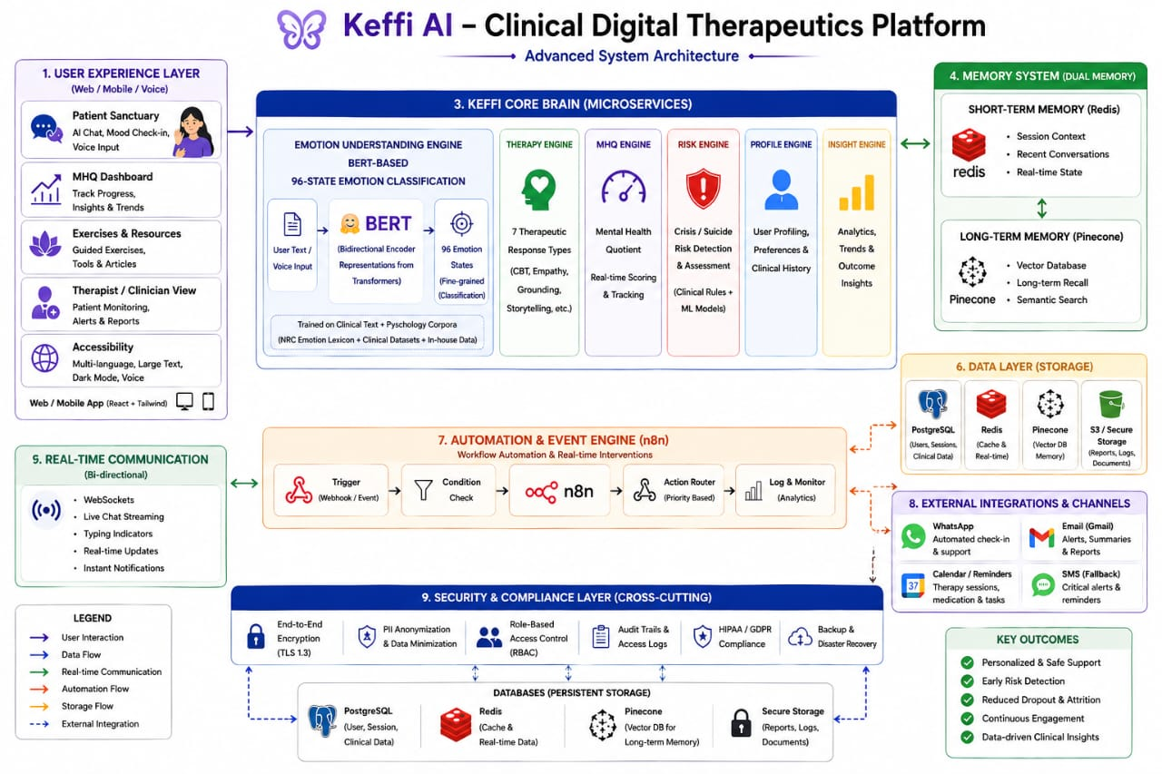

Slide 18
Memory & NLP Core
BERT Model
Performs 96-state emotion classification
Extracts sentiment + confidence score
Vector Database (Pinecone)
Stores conversation embeddings
Enables long-term memory recall
Automation Router (n8n)
Webhook-driven automation engine
Components:
Trigger (incoming event)
Condition check (risk level)
Action router (decision flow)
Logging & monitoring
Handles:
WhatsApp nudges
Crisis alerts
Doctor notifications
External Services & Integrations
WhatsApp → User engagement & nudges
Email → Doctor alerts
Calendar → Reminders & scheduling
Database Layer
PostgreSQL → User & clinical data
Redis → Real-time caching
Pinecone → Vector memory
Secure Storage → Logs & reports

Slide 19
MODULE DESCRIPTION
1. User Experience Layer
Provides interaction through Web / Mobile / Voice interface
Includes:
Chat interface for user communication
Mood check-in system
Dashboard to track mental health progress
Ensures easy, user-friendly and accessible design
2. Emotion Understanding Module
Uses BERT-based NLP model for emotion detection
Processes:
User text / voice input
Converts into embeddings
Classifies into multi-emotion states (fine-grained emotions)
Helps in identifying user’s emotional condition accurately
3. Therapy & Response Engine
Generates context-aware responses
Supports multiple techniques:
Empathy-based replies
Cognitive Behavioral Therapy (CBT)
Grounding techniques
Storytelling-based support
Ensures human-like emotional interaction
4. Mental Health & Risk Analysis Module
Calculates Mental Health Quotient (MHQ)
Performs:
Real-time emotional scoring
Risk detection (stress, anxiety, crisis signals)
Uses AI models + predefined clinical rules
5. Memory System
Short-Term Memory (Redis):
Stores recent conversations
Maintains session context
Long-Term Memory (Pinecone):
Stores past interactions
Enables semantic search & recall
Helps chatbot provide personalized responses

Slide 20
6. Data Storage Layer
Stores structured and unstructured data:
PostgreSQL → User & clinical data
Redis → Real-time cache
Pinecone → Vector memory
Secure Storage → Logs & reports
Ensures efficient and secure data handling
7. Real-Time Communication Module
Enables:
Live chat streaming
Instant responses
Typing indicators
Uses technologies like WebSockets
Ensures smooth real-time interaction
8. Automation & Event Engine
Handles workflows using event-based triggers
Functions:
Detects conditions
Triggers actions (alerts, responses)
Supports real-time intervention and automation
9. External Integration Module
Integrates with:
WhatsApp (chat support)
Email (alerts & reports)
SMS (critical notifications)
Calendar (reminders)
Expands chatbot reach and usability
10. Security & Compliance Layer
Ensures:
End-to-End Encryption
Role-Based Access Control (RBAC)
Data privacy & anonymization
Supports secure and ethical AI usage

Slide 21
CORE ARCHITECTURE – N8N AUTOMATION ENGINE
Entry Point — FastAPI Webhook
This is where everything begins. A patient sends a message (likely through a chat interface or WhatsApp), and that message hits your FastAPI webhook as an HTTP POST request. FastAPI acts as the front door — it receives the raw message payload and immediately passes it into the n8n workflow. This is your system's trigger node, meaning nothing runs until this webhook fires.
Branch 1 — Premium Pipeline (The Core AI Chain)
When the Triage node classifies a message as premium, it enters a sequential 3-AI chain — each model building on the previous one's output:
Step 1 — Gemini (Diagnosis Engine)
The patient's message is sent to Google's Gemini via the Generative Language API. Gemini's job is purely clinical — it analyses the symptoms, duration, and severity described by the patient and generates a structured clinical diagnosis. It might return a differential diagnosis list or a primary suspected condition. This output is not patient-facing yet — it's raw clinical data.

Slide 22
Step 2 — Claude (Empathy Story Engine)
Gemini's clinical output is then passed to Anthropic's Claude. Claude's job is to take that cold, clinical diagnosis and wrap it in compassionate, human language. It rewrites the information so the patient doesn't feel like they're reading a medical report. Claude handles the emotional layer — reducing anxiety, using culturally sensitive language, and making the patient feel heard. This is why Claude specifically was chosen for this step — it excels at nuanced, empathetic communication.
Step 3 — ChatGPT (Options Engine)
Claude's empathetic response is then passed to OpenAI's ChatGPT. ChatGPT's role is to generate clear, actionable next steps for the patient — things like "visit a clinic," "take these OTC medications," "call emergency services," or "monitor at home." It formats the response as a numbered menu of options so the patient knows exactly what to do next. This is the final response that gets sent back to the patient.
Branch 2 — Normal Chat
If the Triage node decides the message is a simple, non-clinical query, it skips all three AI models entirely and returns a standard conversational reply directly. This keeps costs low and response time fast for messages that don't need clinical processing — things like greetings, appointment questions, or general information requests.

Slide 23
Branch 3 — Crisis Protocol (Safety-Critical Path)
This is arguably the most important branch from a patient safety perspective. When the Triage node detects crisis indicators — suicidal ideation, self-harm language, medical emergencies — two things happen simultaneously or in sequence:
WhatsApp SOS Alert (Twilio)
An automated WhatsApp message is instantly fired to a designated emergency contact — likely a clinical supervisor, on-call doctor, or crisis team — via the Twilio API. This happens without any human initiating it. The clinician is alerted in real time.
Return Crisis Protocol
A pre-written, clinically-approved crisis response is sent back to the patient. This is hardcoded content — it does NOT go through Gemini, Claude, or ChatGPT. This is a deliberate safety design decision: LLMs can hallucinate, and a hallucinated response to someone in crisis could be catastrophic. The response contains things like helpline numbers, grounding instructions, and immediate next steps.

Slide 24
ADVANTAGE
1.96-State Emotion Understanding
Other bots: 3–5 basic emotions
Keffi: 96 clinically classified states (41 depression types, 20 attrition types, 17 loss-of-follow-up types)
Powered by BERT — reads context bidirectionally, not just keywords
2.Vector Memory (Pinecone)
Other bots: Stateless — no memory between sessions
Keffi: Stores conversation embeddings → builds a continuous psychological profile over time
Remembers past pain points, triggers, and progress
3.Dynamic MHQ Scoring
Other bots: No health scoring system
Keffi: Live Mental Health Quotient (0–100) updated every session, mapped to PHQ clinical standards

Slide 25
4.Triple-AI Architecture
Other bots: Single LLM
Keffi uses 3 specialized AIs in parallel:
Gemini → Deep diagnosis & pattern analysis Claude → Human-like empathy & storytelling ChatGPT → Structured A/B/C guided options
5.Predictive Attrition Engine
Other bots: React only when user messages
Keffi: Predicts dropout before it happens → triggers WhatsApp nudges, reminders, alerts via n8n
6.Clinical Crisis Protocol
Other bots: Show a helpline number at best
Keffi: Follows C-SSRS + WHO protocols → auto-alerts doctor, sends WhatsApp SOS, activates crisis response
7.Two-Sided Platform
Other bots: Only patient-facing
Keffi: Patient app + Clinical Hub dashboard for doctors with NLP analytics, patient roster, therapist allocation

Slide 26
SYSTEM REQUIREMENTS
1. Hardware Requirements
Processor: Intel i3 / AMD equivalent or higher
RAM: Minimum 4 GB (8 GB recommended)
Storage: 10 GB free disk space
Device: Laptop / Desktop / Smartphone
Internet: Stable connection for real-time interaction
2. Software Requirements
Operating System: Windows / Linux / macOS
Programming Language: Python
Frameworks: FastAPI / Flask
Frontend: React.js / HTML / CSS / Tailwind
Database: PostgreSQL
Tools: Google Colab / VS Code / Jupyter Notebook
3. AI & NLP Requirements
NLP Model: BERT (Bidirectional Encoder Representations from Transformers)
Libraries:
Transformers (Hugging Face)
TensorFlow / PyTorch
NLTK / SpaCy
Emotion Dataset: GoEmotions / Custom dataset
4. Storage & Memory Requirements
Short-Term Memory: Redis
Long-Term Memory: Pinecone (Vector Database)
File Storage: Cloud / Local storage
5. Communication Requirements
WebSockets for real-time chat
REST APIs for backend communication
Internet connectivity for API calls
6. Security Requirements
User data encryption (HTTPS / TLS)
Authentication & Authorization
Data privacy and anonymization
Secure database access

Slide 27
ROADMAP
Phase 1 — Now (Current Prototype)
What's built:
Full React + Tailwind UI (Patient Sanctuary + Clinical Hub)
BERT-based 96-state emotion engine via FastAPI
Pinecone vector memory system
MHQ dynamic scoring (0–100)
Attrition prediction algorithm
n8n automation pipeline
7 therapeutic AI response types
Phase 2 — 3 Months (Deployment & Engagement)
What's planned:
Cloud deployment on AWS / Vercel for real users
WhatsApp integration — reach users where they already are
Automated engagement — scheduled check-ins, mood nudges, streak reminders
Multi-language support — Tamil, Hindi, regional languages (building on existing Tamil capability)

Slide 28
Phase 3 — 6 Months (Biometric Intelligence)
What's planned:
Smartwatch / Wearable integration (Apple Watch, Fitbit, Garmin)
Monitor: Heart rate variability, sleep patterns, stress signals
Auto-trigger calming tools when physiological distress detected
Example: Heart rate spikes → Keffi automatically sends 4-7-8 breathing exercise
Phase 4 — 1 Year+ (Clinical Validation & Scale)
What's planned:
IRB-approved clinical trial — validate Keffi in real hospital/clinic setting
Doctor integration — prescribing doctors can view MHQ scores alongside PHQ results
Insurance & healthcare system tie-ins
FDA/CE digital therapeutics certification pathway
Research publication — contribute to the Woebot-level evidence base

Slide 29
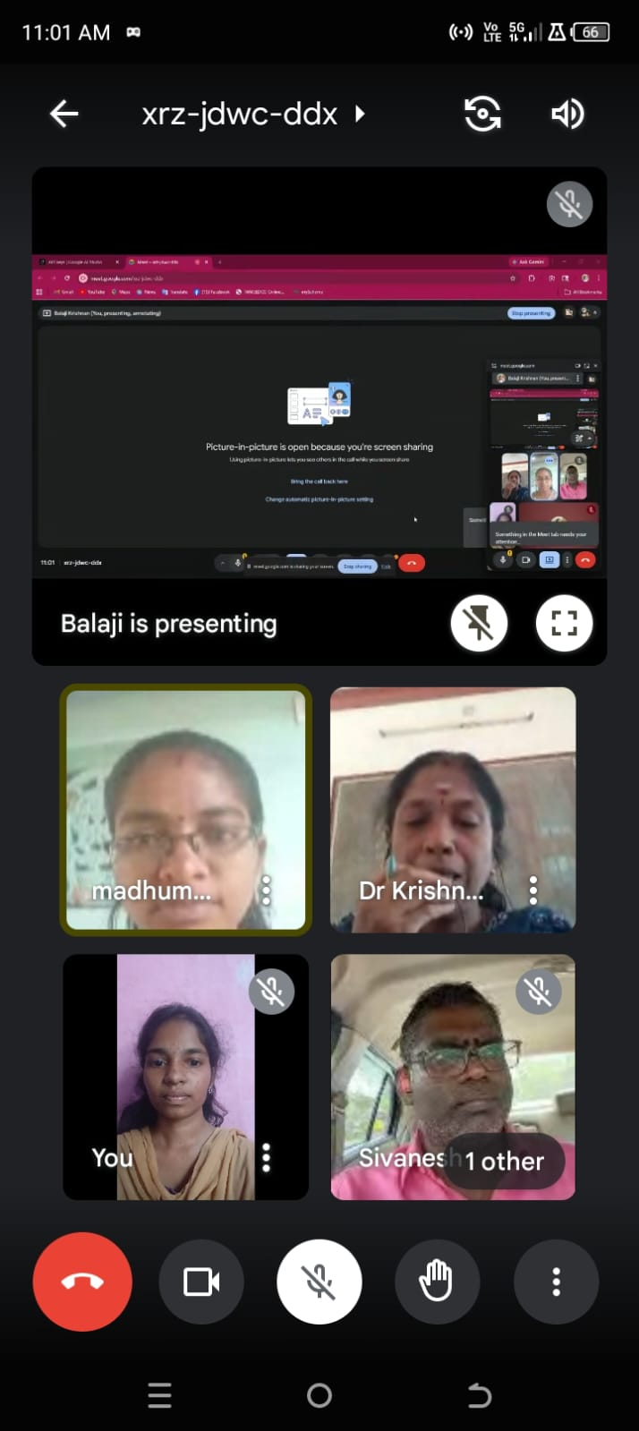
JOURNEY VIDEO REFERENCE
FIRST REVIEW OF OUR
PROJECT WITH COLLEGE
MENTOR

Slide 30
CONCLUSION
Keffi AI is not just a traditional chatbot but a clinically inspired digital mental health platform that combines artificial intelligence with proven psychological frameworks to deliver personalized and real-time support. By understanding 96+ emotional and depression states, integrating therapeutic response strategies like CBT and empathy-based interaction, and enabling automation through systems like n8n, the platform ensures both intelligent conversation and timely intervention. It addresses key limitations of existing solutions such as lack of memory, poor personalization, and absence of safety mechanisms. With features like MHQ scoring, attrition prediction, and
future integration with wearable devices, Keffi AI moves towards a proactive and continuous mental healthcare
model. Overall, it represents a shift from reactive chatbot systems to a smart, scalable, and clinically aware mental
health ecosystem capable of supporting users effectively and bridging the gap between technology and healthcare.

Slide 31
THANK YOU

